Slide 1
NBA Hurts: Injuries in Professional Basketball, 2010-2018
Mark Bickerton, Justin Hobbs, Mychal Spivey, Katy Webb

Slide 2

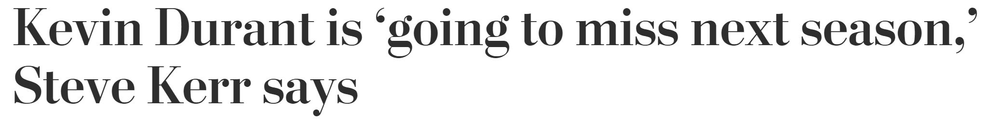
Risks of Injured Players
Kevin Durant’s 2017 contract: $26.54 million
LA Times, 6/12/19
The Washington Post, 6/14/19

Slide 3


The issue: Players are expensive, teams want to win
NOTE:
To change images on this slide, select a picture and delete it. Then click the Insert Picture icon
in the placeholder to insert your own image.
RAWR!!!
Fewer injuries mean more active players, better team performance

Slide 4
Who gets injured the most in the NBA?
What are the most common injuries in the NBA?
Are players with certain characteristics more likely to be injured?
Age?
Size?
Position?
Collegiate training?
If we know who is more likely to be injured, can we build a team that may be less injury-prone (and make $$$ off the NBA in consulting fees in the process)?
Don’t judge us, ain’t nobody work for free!!!

Slide 5
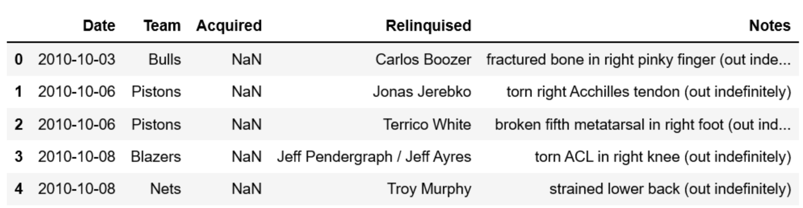

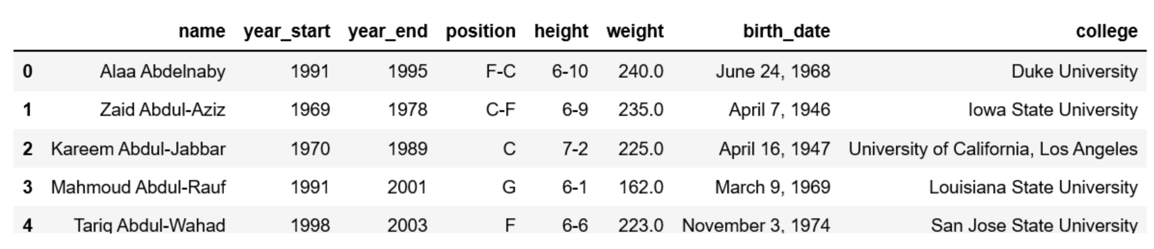
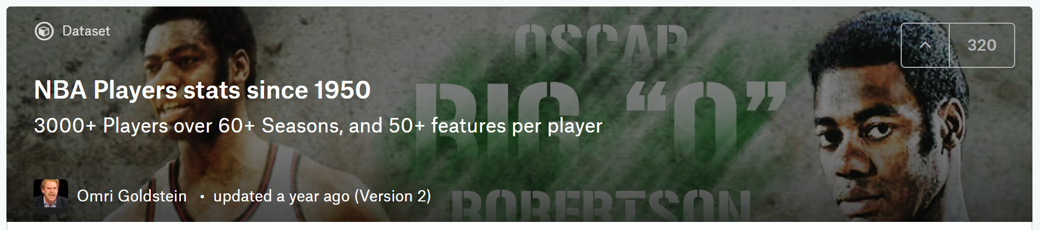
Data Sources via Google
www.kaggel.com
www.kaggle.com

Slide 6
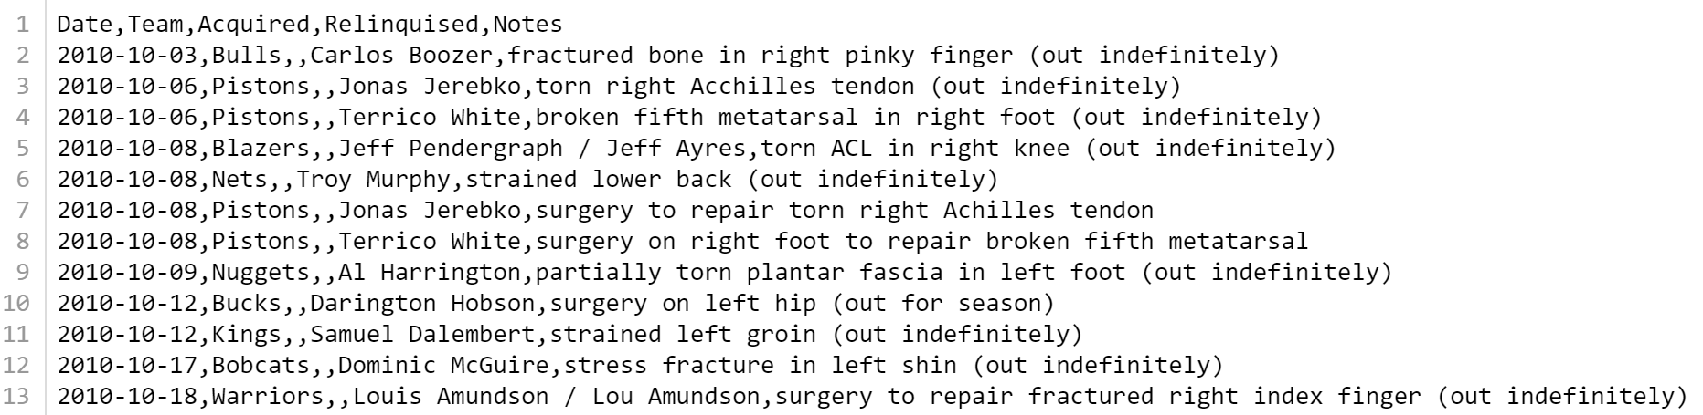
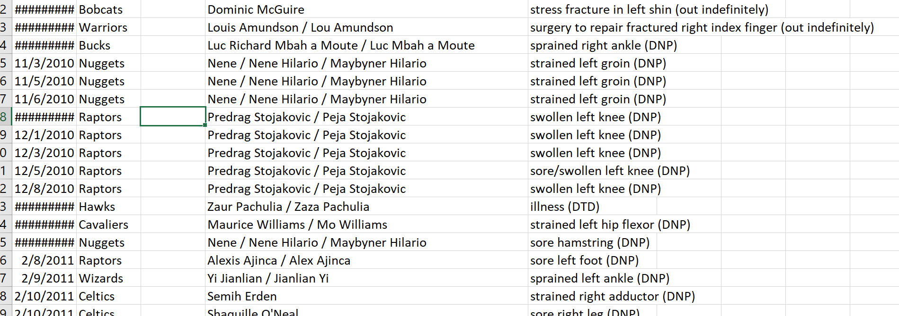
Data Munging, OMG the munging…
No one dataset had all the info we needed
Issues: duplicate, even triplicate player names
No distinct injury entries or categories; all grouped in a ‘Notes’ column
Data in Imperial vs metric units
Multiple players had multiple injuries within the same season and across seasons

Slide 7
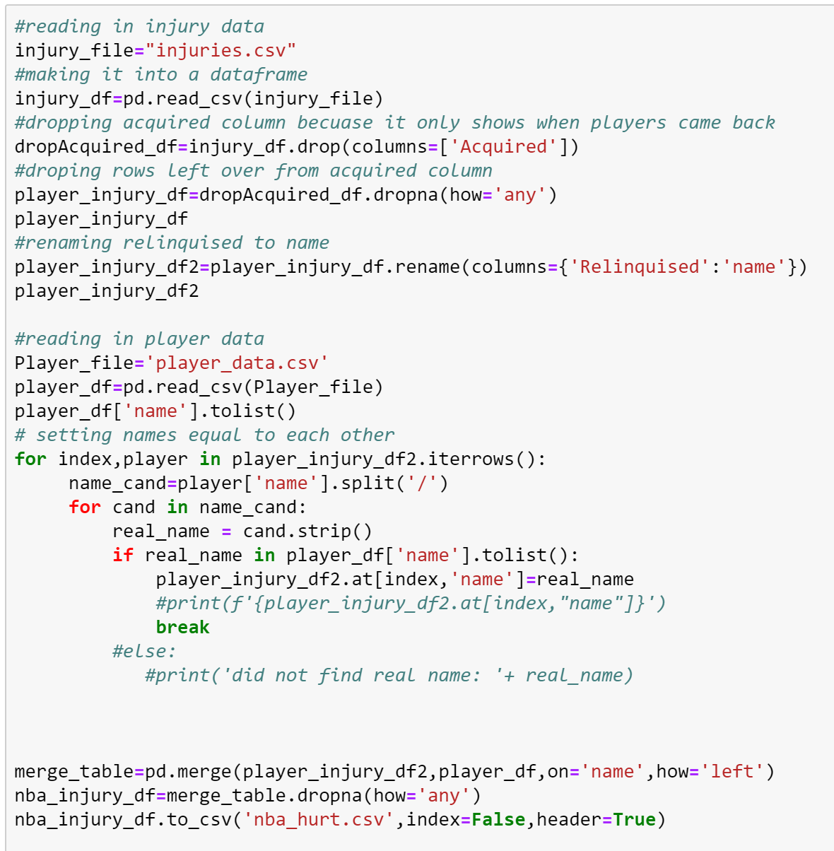

Slide 8
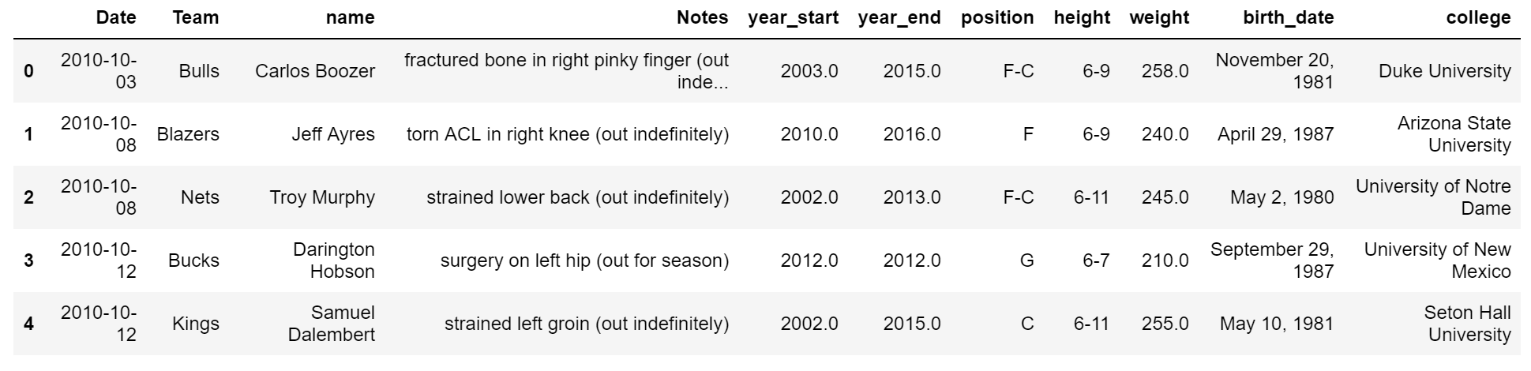

Slide 9
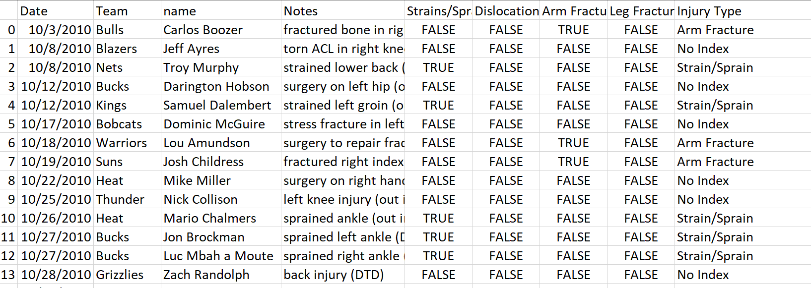

Slide 10
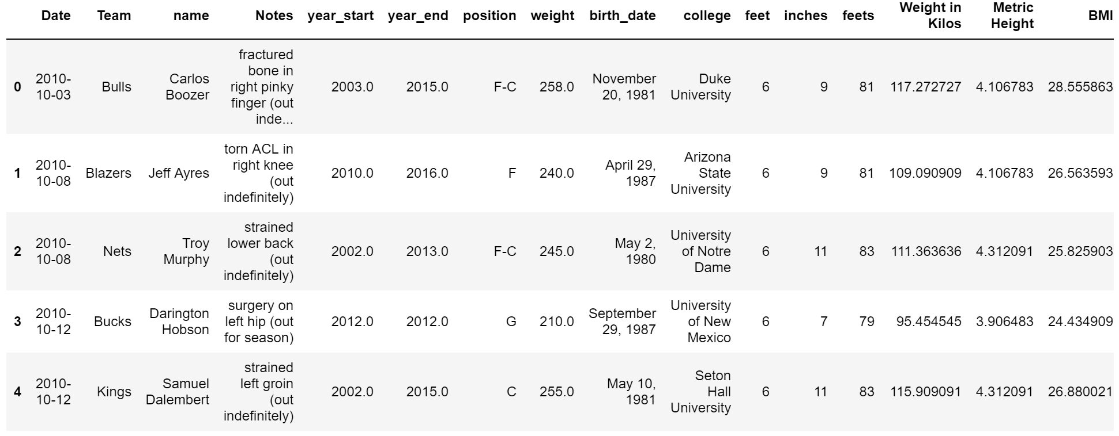







Slide 11
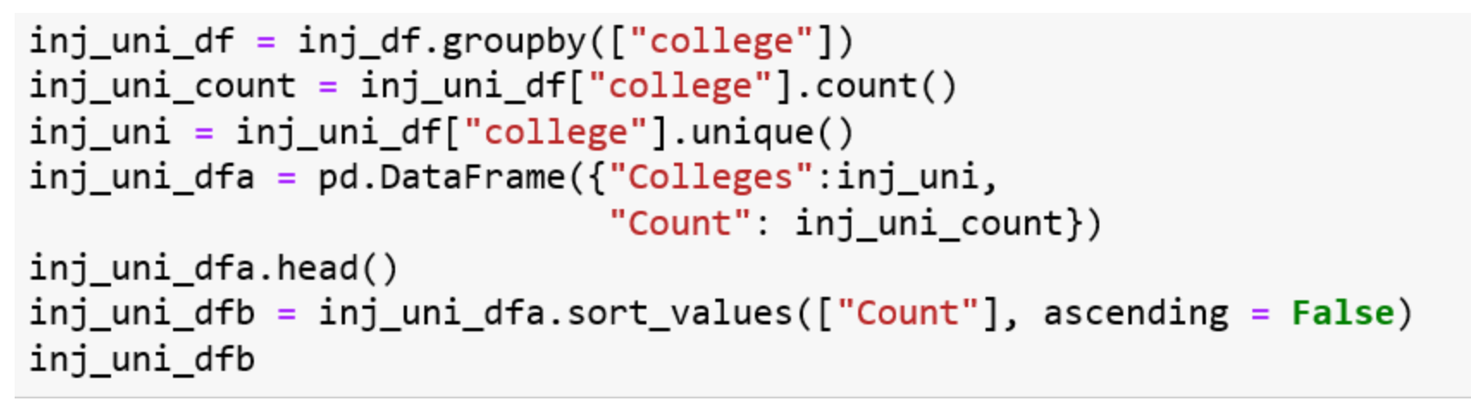
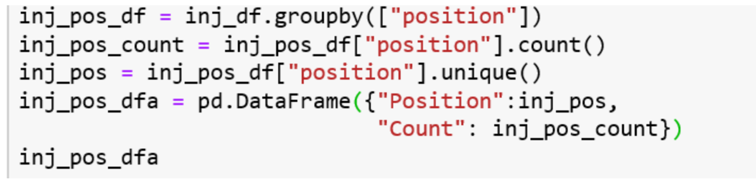
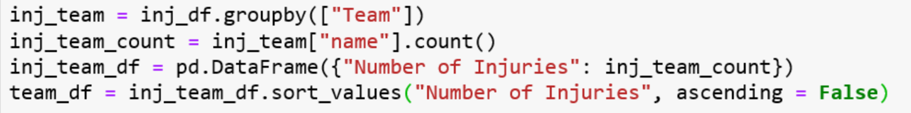

Slide 12
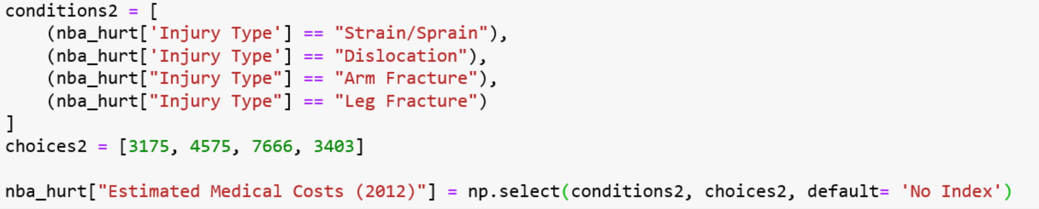
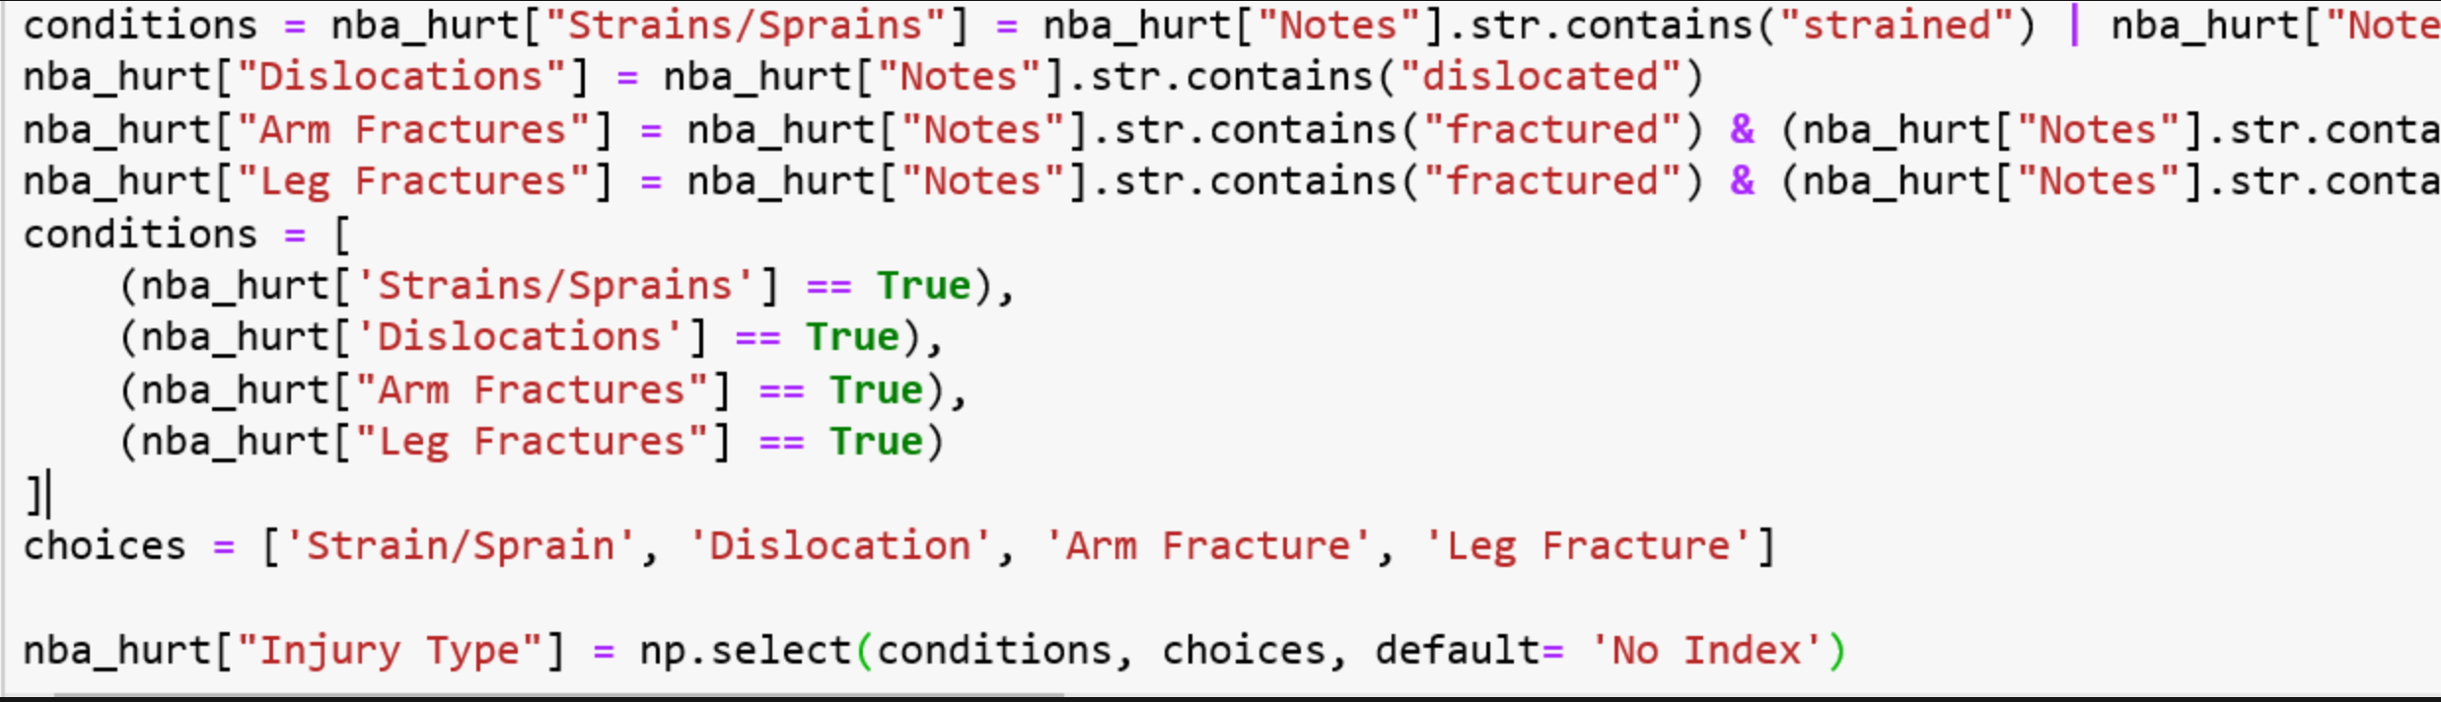

Slide 13
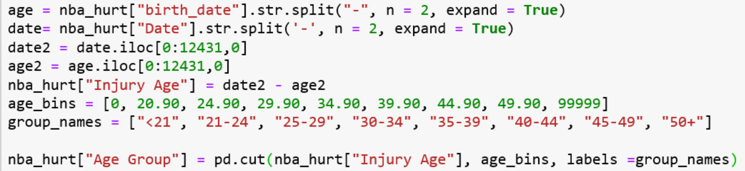

Slide 14
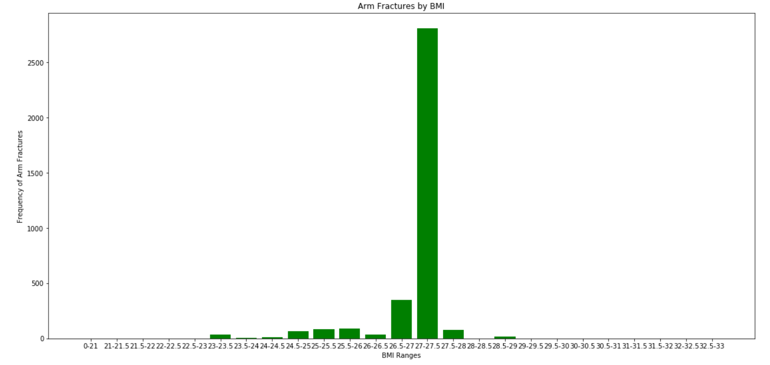
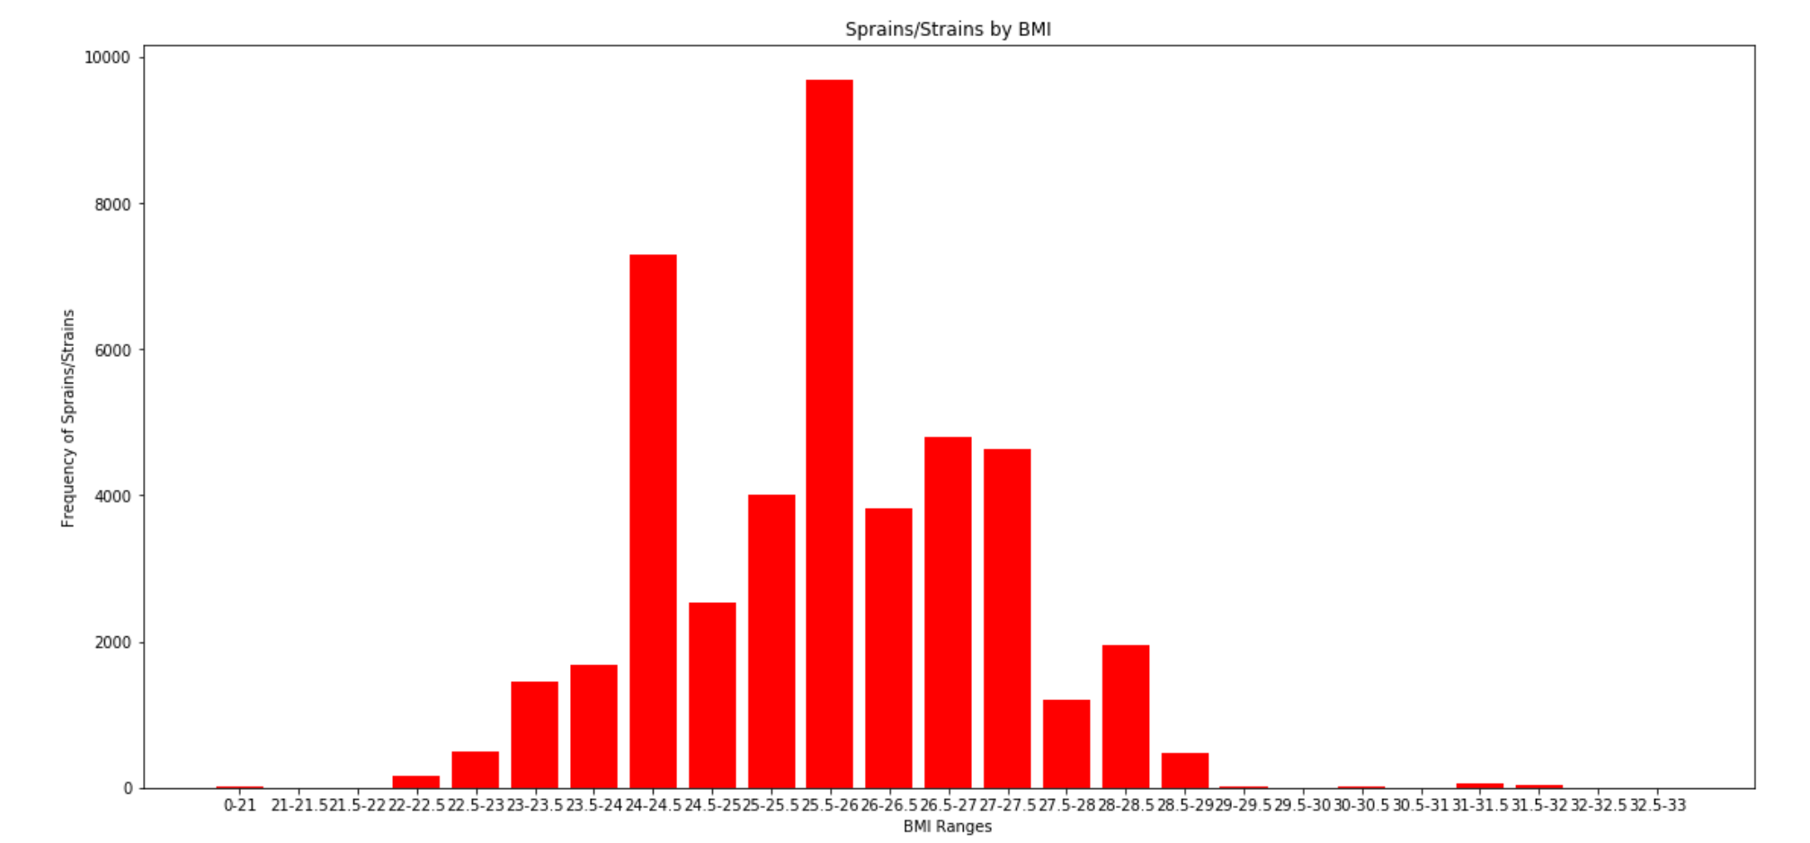
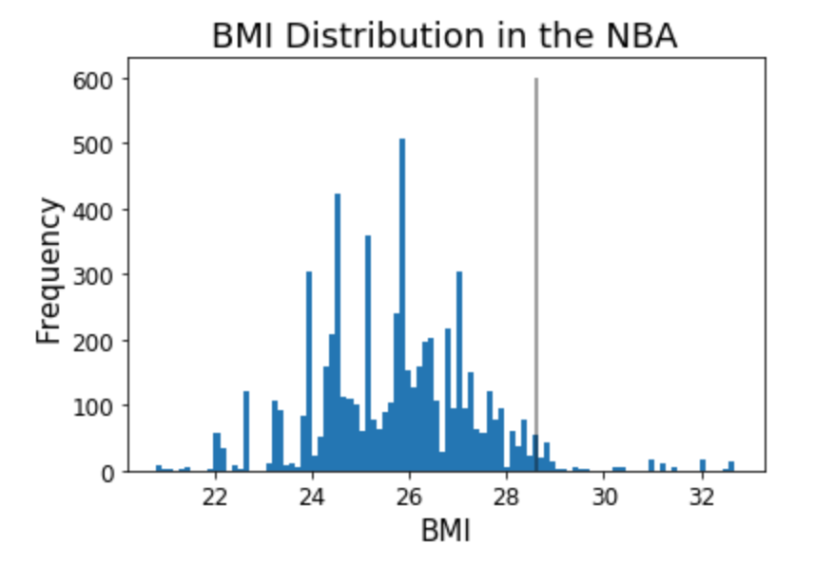
Mean BMI: 25.7
Mode Injury by BMI: 25.5-26

Slide 15
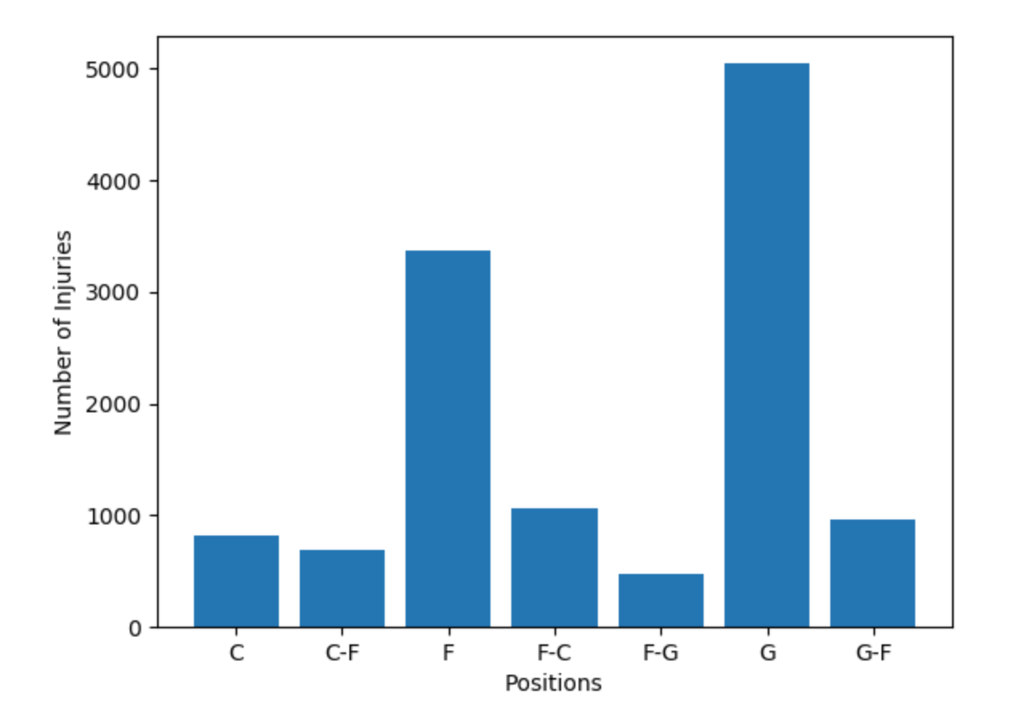

Slide 16
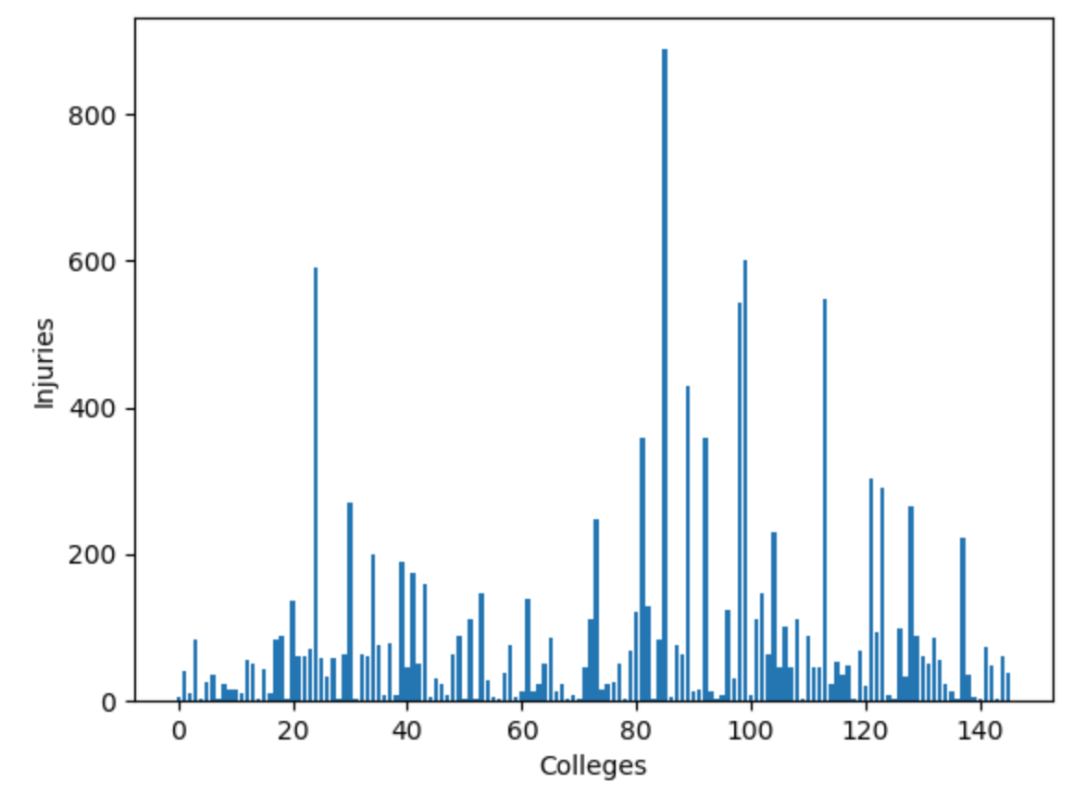
UCLA

Slide 17
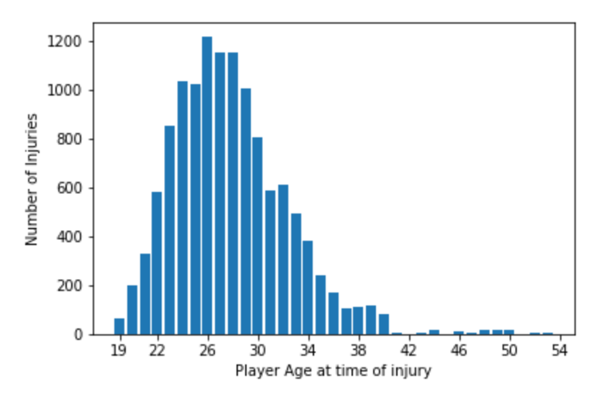
Mean age of NBA players- 26.8

Slide 18
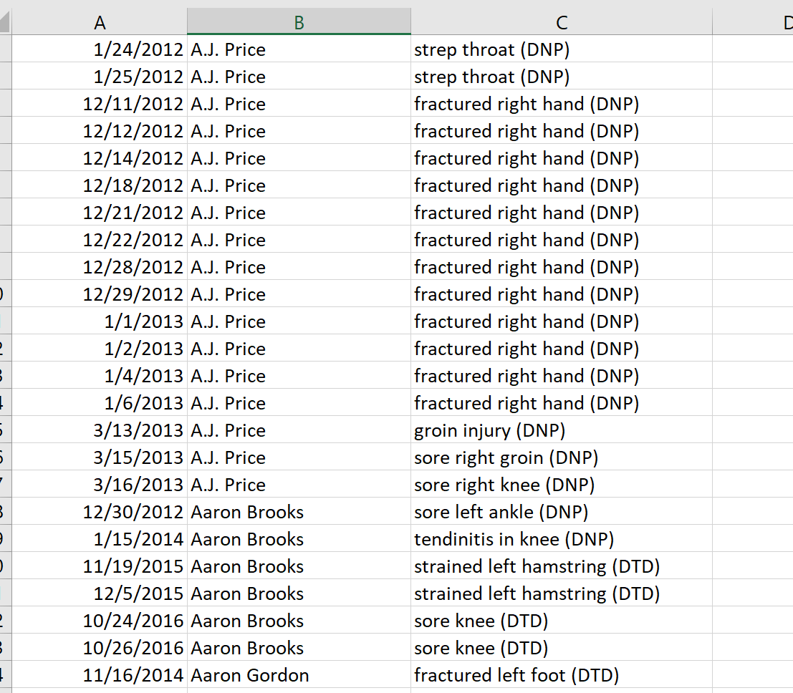
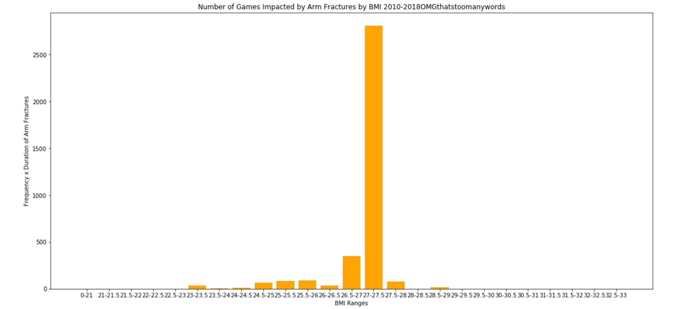

Limitations/Considerations
Were there really 2,808 arm fractures in players with a BMI of 27-27.5?!
The dataset shows not only the occurrence of each player’s injury, but also the number of games that player was sidelined with the injury; i.e. the dataset is injuries, compounded by injury duration
This isn’t necessarily a bad thing:
What we can relate to the NBA is not only who is more likely to be injured, but also give them a sense of the cumulative impact of the injury
What about the stats?

Slide 19
Conclusions
-Sprains and Strains
What are the most common injuries in the NBA?
Are players with certain characteristics more likely to be injured?
Age?
Size?
Position?
Collegiate training?
We would recommend to the NBA that they provide extra PT resources for their Guards, perhaps examine training strategies to see if there is a way to maintain good guarding but with fewer risks to players (modify strategies used by college teams)
Additional analyses could include: Fine-tuning the injury buckets (e.g. sprained left ankle, torn ACL, concussions, etc.), calculating ratio of salary vs days sidelined
-26, 26-28
–BMI 25.5-26
-Guards
-UCLA

Slide 20

Thanks!

